Slide 1
Tips & graphics
for the CBS PowerPoint template

Slide 2
What is this?
This is a presentation with tips and graphics for you to get the best out of the CBS PowerPoint template

Slide 3
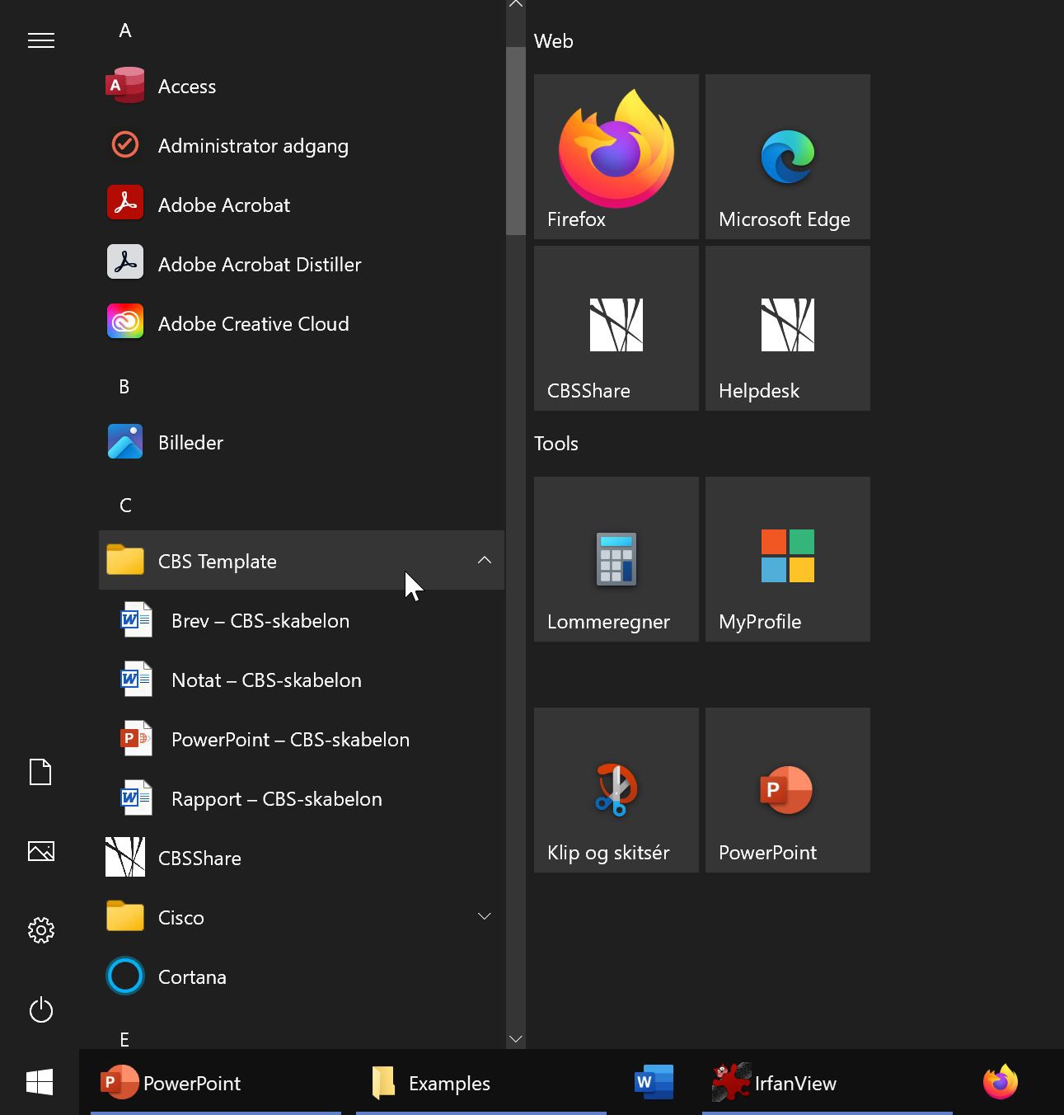
CBS templates
If you are working on a PC, the CBS templates are already in your start menu – no need to download them

Slide 4
How to create a new CBS slide
PC
Press the arrow next to “New slide” to choose from 28 different CBS slides
If you press the icon instead, you get the same slide as the one you are currently working on
Mac

Slide 5
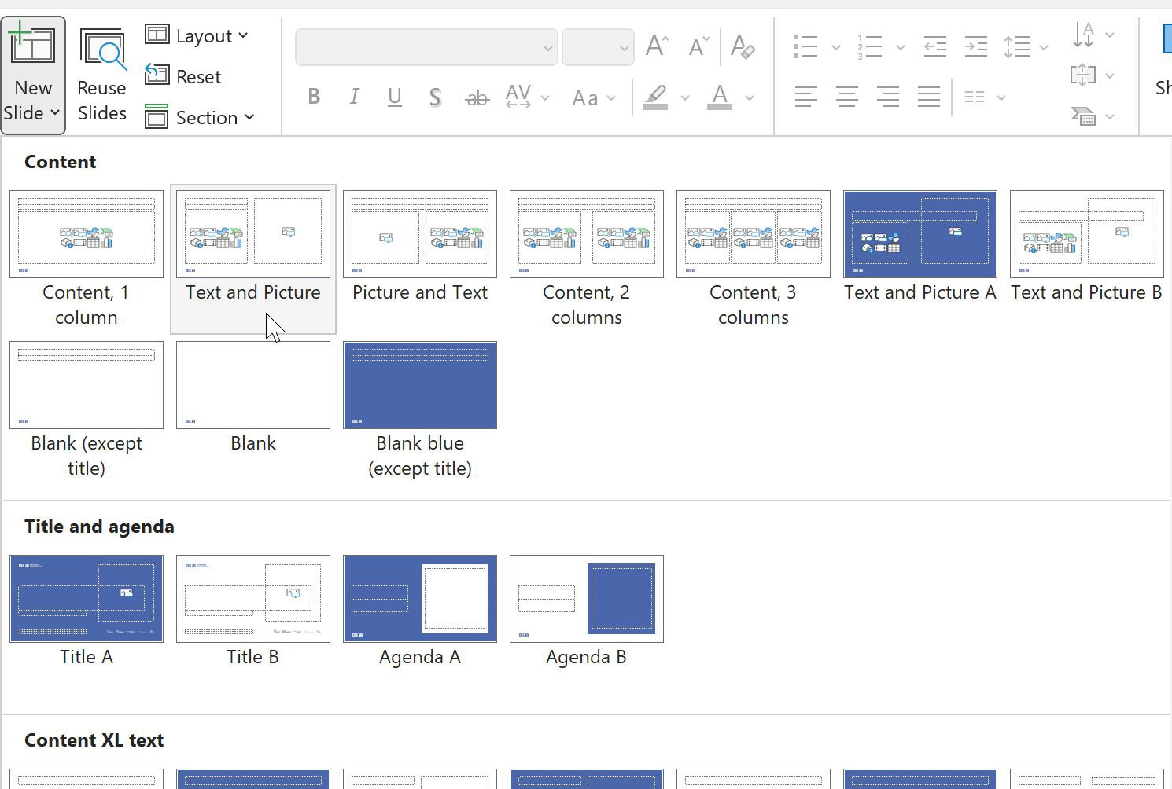
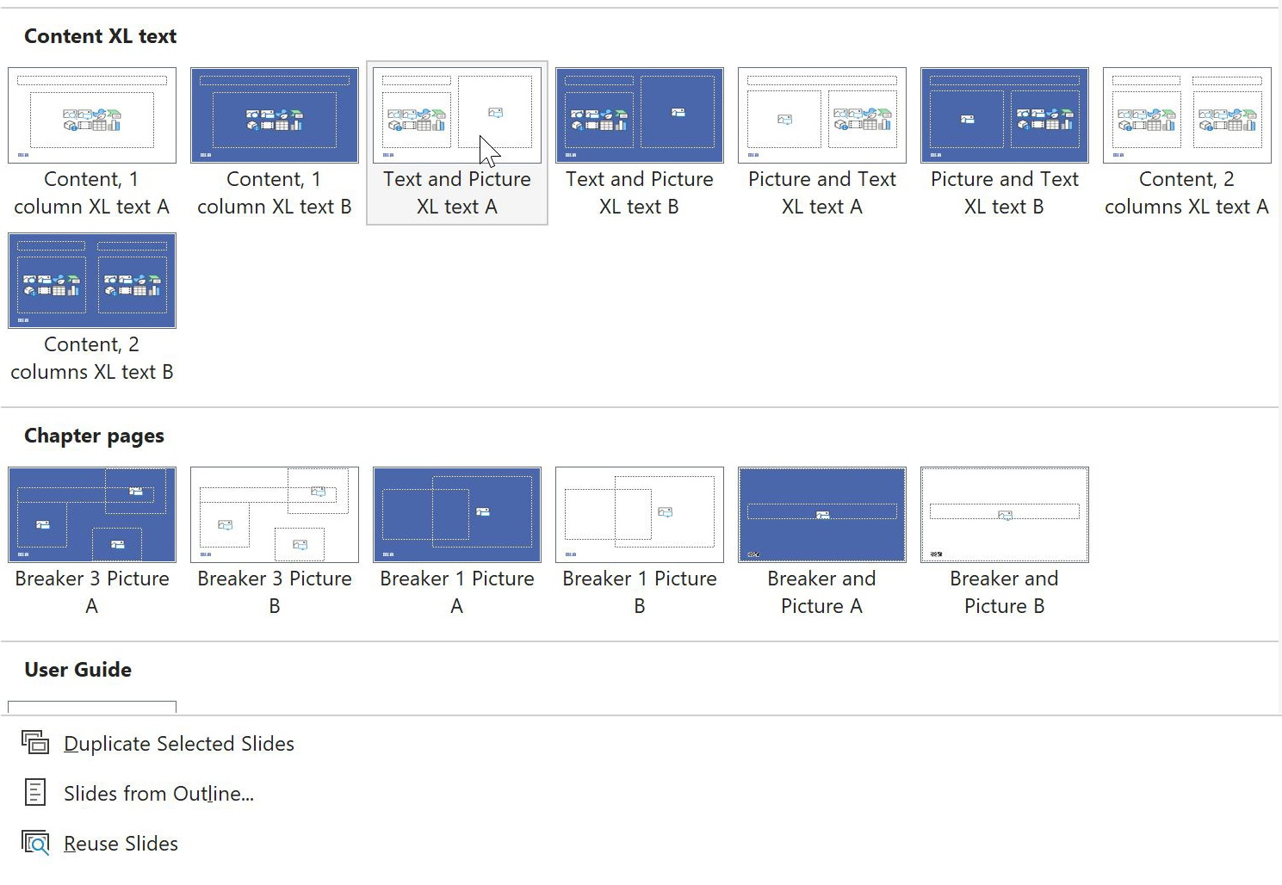
28 different CBS slides
There are slides for titles and agendas, content, content XL and chapter pages

Slide 6
Content XL: Extra large text
These are slides meant for a presentation in an auditorium
All the eight Content XL slide layouts have large text (25 pt)
This slide uses “Text and Picture XL text A”

Slide 7
Colours
These are the CBS colours
(PowerPoint automatically creates tints of the theme colours – only use them if needed)
Please do not use these colours

Slide 8
Photos
CBS photo database: photo.cbs.dk
The database is for CBS employees only
You have access to the database if you are on campus or VPN

Slide 9
Grid
If you need a background grid to place your elements, go to “View” and select “Guides”

Slide 10
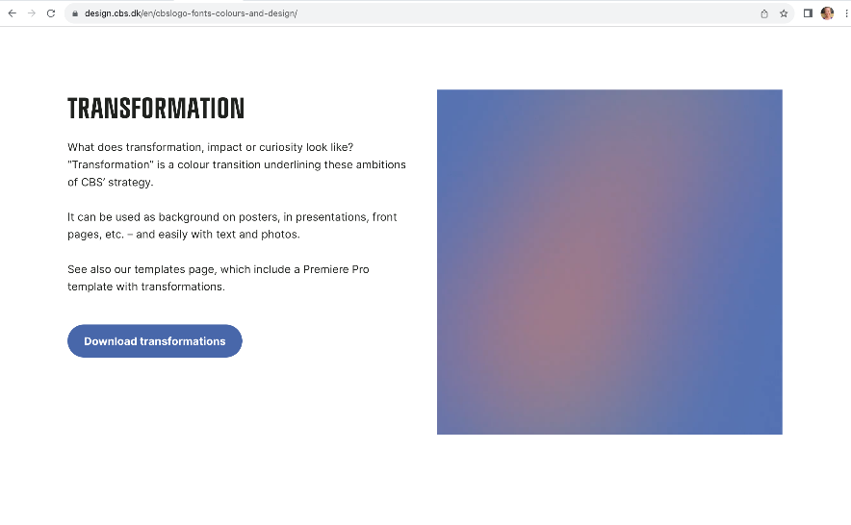
Transformation background
You can download gradient backgrounds in the designguide
The gradients come in three diffent colours and six shapes

Slide 11
Transformation background

Slide 12
Transformation background

Slide 13
Transformation background

Slide 14
Transformation background

Slide 15
Transformation background

Slide 16
Illustrations
Can also be downloaded from design.cbs.dk as .ai-files, png or svg

Slide 17
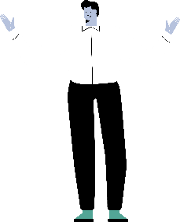
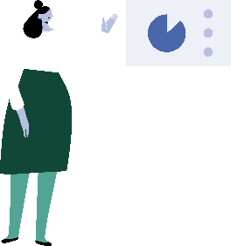
Illustrations
Can also be downloaded from design.cbs.dk as .ai-files, png or svg

Slide 18
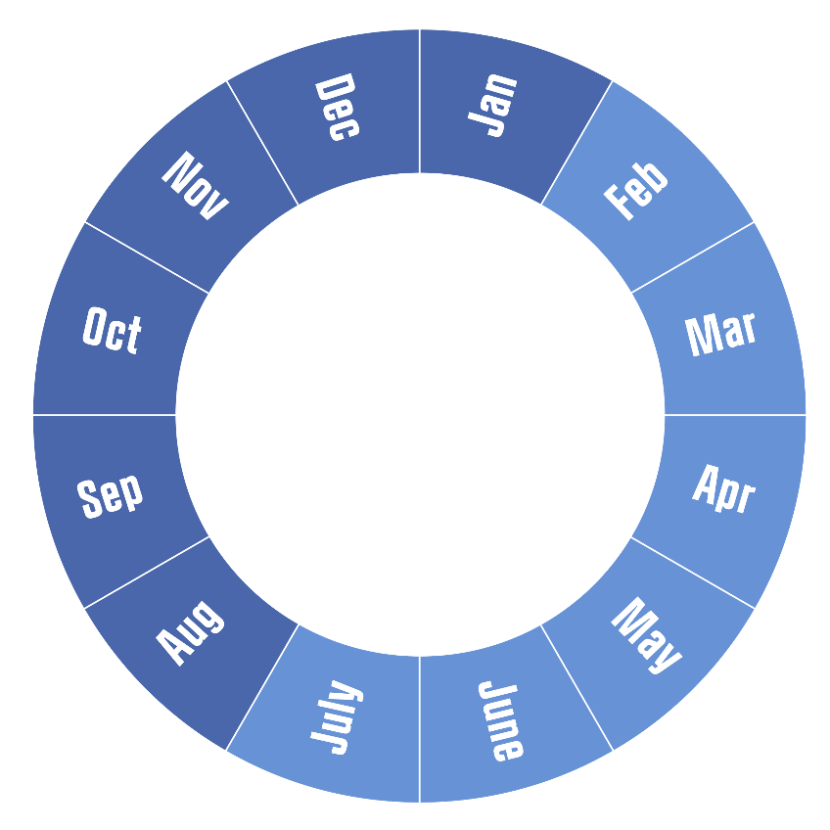
Årshjul / Annual wheel
Headline
Text here
Headline
Text here
Headline
Text here
2023

Slide 19
Tidslinje / Timeline
August
September
Oktober
Week 33 | 34 | 35 | 36 | 37 | 38 | 39 | 40
Uge 33
Workshop 1
Text
Uge 34
Workshop 2
Text
29/8
Presentation
Text
6/9-11/9
Text
19/9
Text
Text
26/9
Presentation
More text More text More text
4/10
Text
More text More text More text
More text More text More text
25/9
Presentation
More text More text More text
Uge 35-37
Text
Text

Slide 20
Text
Text
Text
Text
Text
Text
Text
Text here
Text here
Text here
Text
Text here
Text here
Text here
Text here
Text
Text here
Text here
Text here
Text here
Text
Text here
Text here
Text here
Text here
Text here

Slide 21
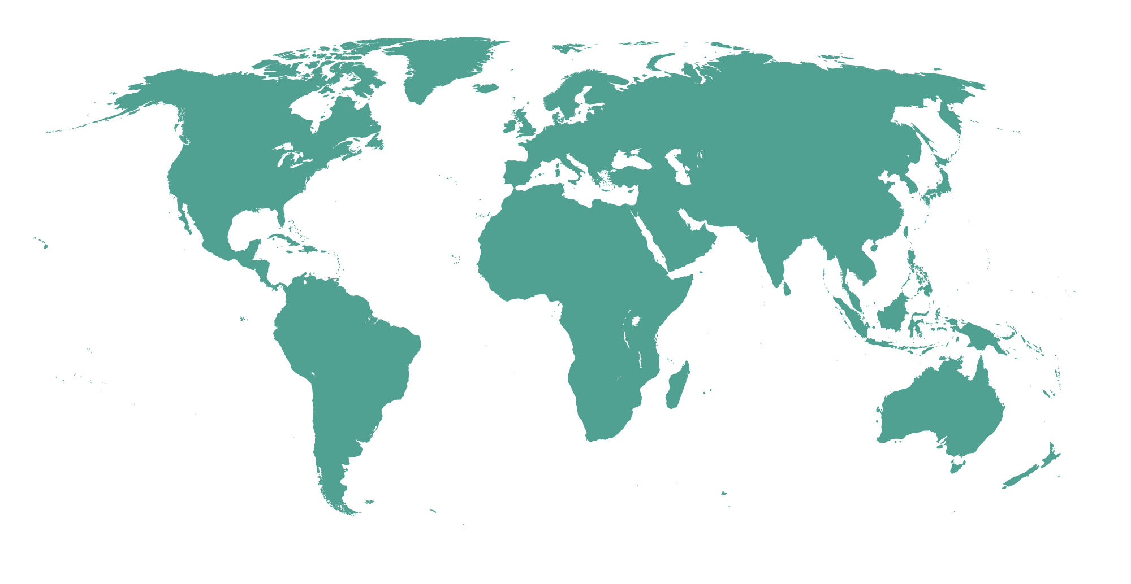
World map
Copenhagen Business School
Notes:
CBS is a highly international university. We maintain a strong focus on our students’ possibility to take parts of their education at a partner university abroad. At the same time, the integration of foreign students is a natural and important added value to the internationalisation of CBS’ own student environment. CBS has exchange and cooperation agreements with universities and business schools all over the world.

Slide 22
Process
Build your own shape
Please see slide 22
Week
Week
Week
Week
Week
Xx Xx
Date
Detail
Date
Detail
Date
Detail
Action
Date
Action
Date
Action
Xx
Xx
Xx
Xx
Xx
Xx
Detail
Date
Actetur, adipisci velit
Lorum ipsum

Slide 23
Pointing boxes
How to merge shapes
This pointing box consists of a square and a rectangle. The shapes are not merged yet – you can transform the rectangle and move the square as you like. Then merge the two shapes.
How to merge shapes:
Select both shapes
Go to Shape Format (top menu)
> Merge Shapes
> Union
Stroke: 0,5 pt.

